Slide 1
Project name: Car Crash analysis By crash dummies!
Members: Shreya Udeshi, Ra Ish Andrews, Ellis Purwanto

Slide 2
Table of contents
Introduction
Data Elements
Location Data Frame
Visualization
Person Data Frame
Visualization
Time Data Frame
Visualization
Conclusion
Analysis
Analysis
Analysis

Slide 3
Introduction
The U.S. Department of Transportation, National Highway Traffic Safety Administration issued a car crash report.
Accidents in 2018 appear to relate to three variables: location, time, and driver demographic.
We will evaluate a variety of subcategories within the data set during our research, including Region (in terms of localities), Date (in terms of time), and Age and Gender (in reference to person’s demographic).
SOURCE: https://www.nhtsa.gov/file-downloads?p=nhtsa/downloads/CRSS/

Slide 4
Objectives
Understand
Understand Data
Discover
Discover Patterns
Establish
Establish Relationships Between Data Elements

Slide 6
Data Elements
Location Data Frame:
Manner_of_Collision, REGION, URBANICITY
Person Data Frame:
AGE_IM, SEX_IM, INJSEV_IM
Time Data Frame:
CASENUM, NUM_INJ, URBANICITY, MONTH, WKDY_IM, HOUR_IM

Slide 7
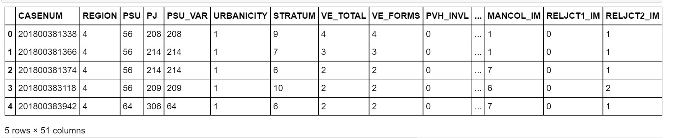
Location Data frame

Slide 8
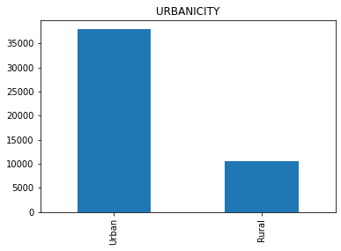
Urbanacity
Fig 1-1 Shows a comparison between the number of accidents and the Urbancity
Urban areas contain a population of 250,000 or greater
Significantly more accidents in Urban Areas than Rural

Slide 9
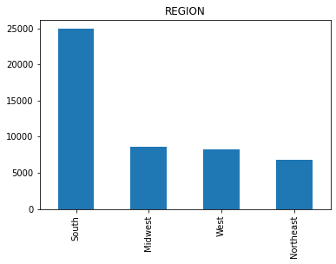
Region
Figure 1-2 shows a comparison between the number of accidents and the region they took place
Northeast (PA, NJ, NY, NH, VT, RI, MA, ME, CT)
Midwest (OH, IN, IL, MI, WI, MN, ND, SD, NE, IA, MO, KS)
South (MD, DE, DC, WV, VA, KY, TN, NC, SC, GA, FL, AL, MS, LA, AR, OK, TX)
4 West (MT, ID, WA, OR, CA, NV, NM, AZ, UT, CO, WY, AK, HI)
Significantly More accidents in the south than any other region

Slide 10
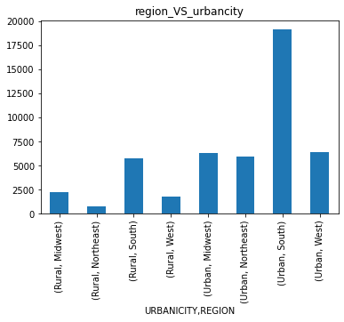
Region Vs Urbancity
Figure 1-3 combines the data, comapring Region vs Urbanacity
Most accidents occur within the Urban areas of the South

Slide 11
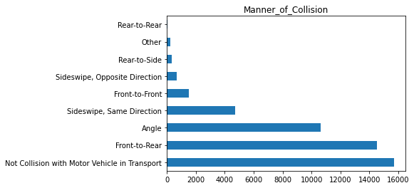
Manner of Collision Vs Number of Accidents
Figure 1-4 Shows the comparisons of the number of accidents vs the manor in which they occurred
"Manner of Collision" describes the orientation of two motor vehicles in-transport when they are involved in the “First Harmful Event” of a collision crash

Slide 12
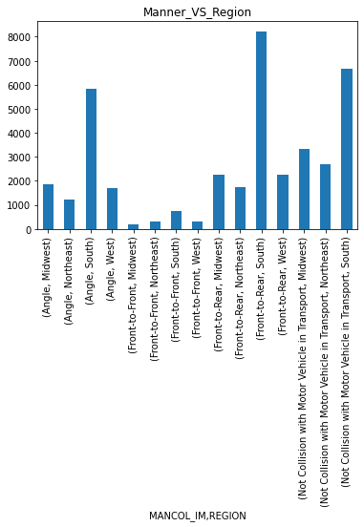
Manner of Collision V/s Region
Figure 1-5 Combines the data from region and Manner of Collision for a final comparison
Out of the top 15- Most accidents happen Front-to-Rear in the South

Slide 13
ANALYSIS
Where are most accidents occurring? Why?
Most accidents in the data set are occurring in the south from Front to Rear accidents.
This could be caused to congestion on highways in highly populated areas.
Also, studies show that the south tends to be more behind in infrastructure and development than other areas of the US

Slide 14
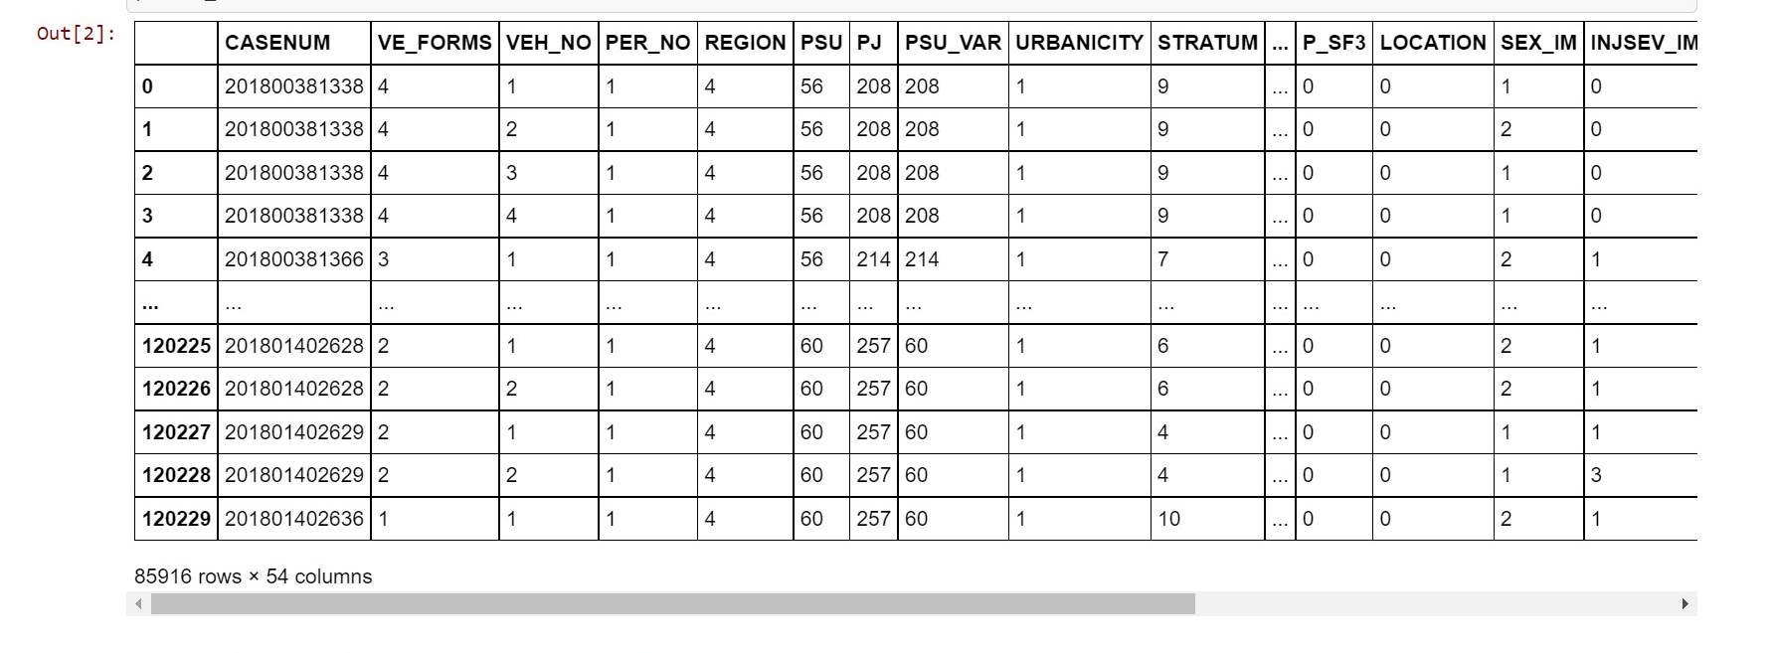
Persons DATA FRAME

Slide 15
Persons DATA FRAME
Data Analysis with Python and Pandas using Jupyter Notebook
Filtered and cleaned the data to only use driver information
Created and counted age groups using .loc and len() functions
Stacked horizontal bar plots using matplotlib library

Slide 16
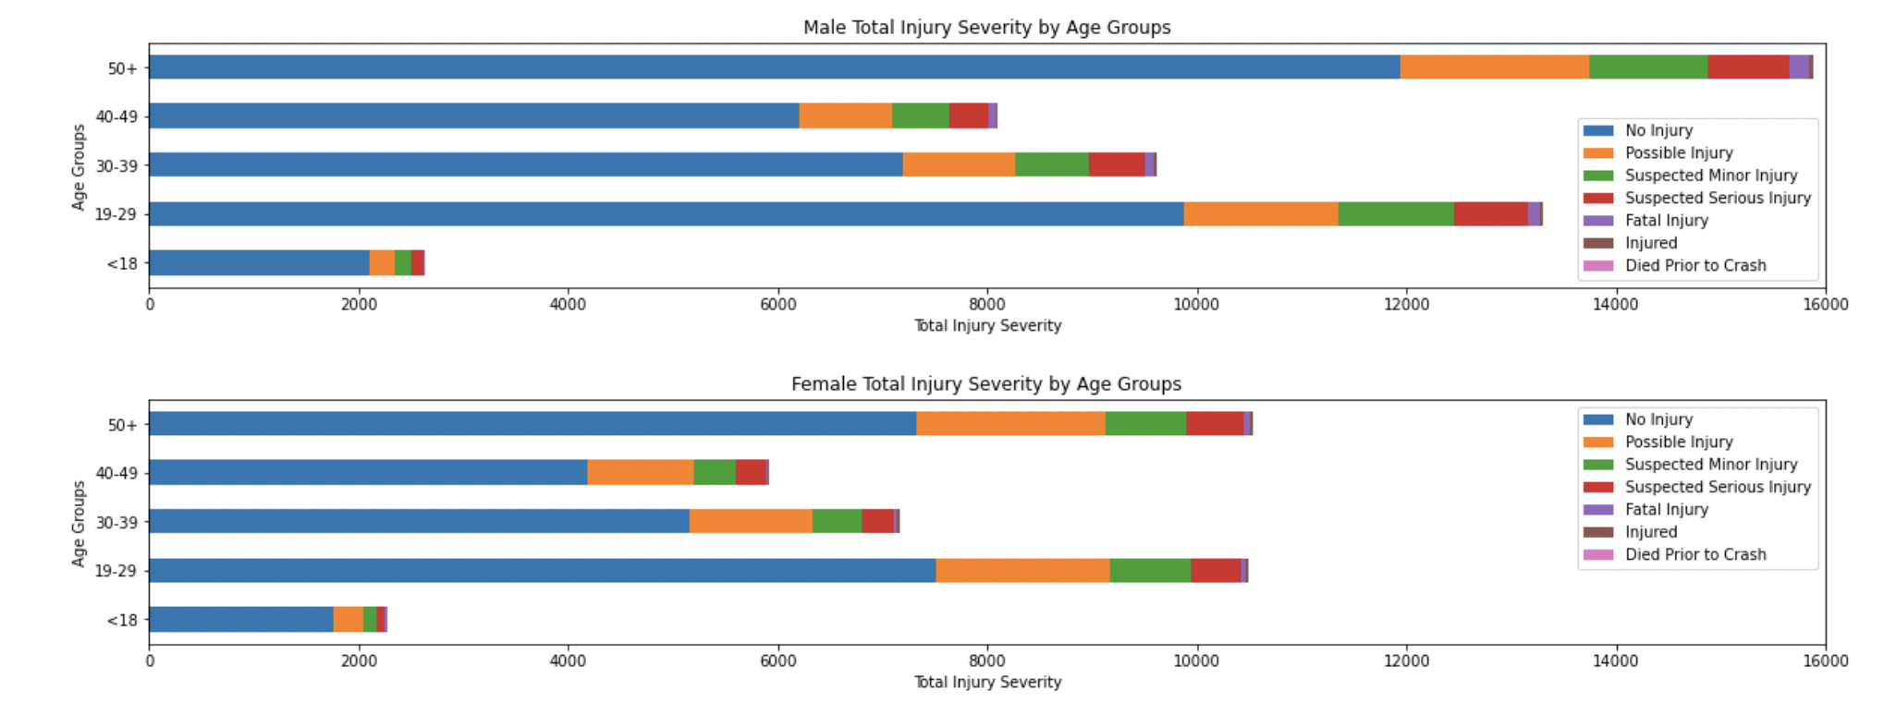
Visualization

Slide 17
Analysis
As shown in the visualizations below, it can be inferred that Males tend to drive more recklessly than Females.
Fatal Injuries tend to occur in Male Senior Drivers than any other Age Group.
Male adults aged 50 and up tend to have much more total accidents than both the <18 and 19-29 age groups combined.
Surprisingly, the <18 age group has significantly less accidents than every other age group, which could be caused by teens delaying getting a driver license or a stricter rules imposed by local authorities.
Although many accidents occur each year, over half of them, regardless of gender or age, result in No Injury.

Slide 18
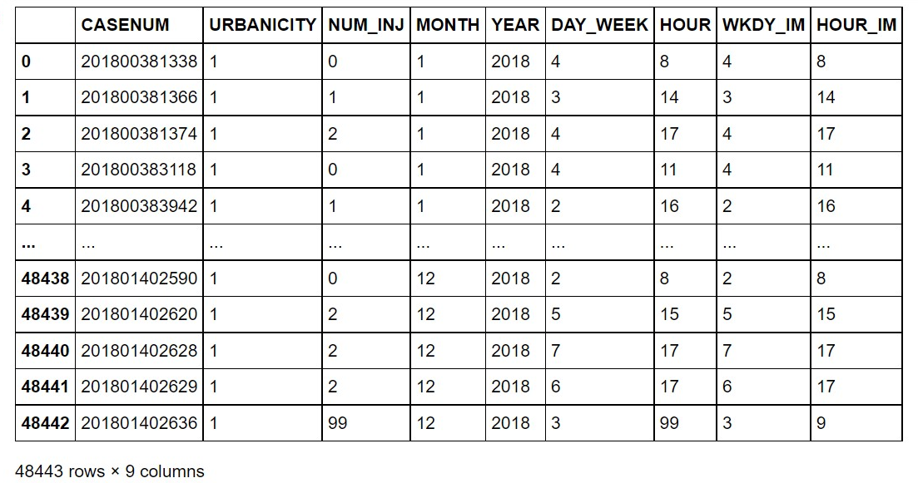
Time data frame

Slide 19
Time data frame
Utilized Python scripting, pandas and matplotlib library using Jupyter Notebook
View data and establish initial insights
Read csv file as a data frame
Filtered and cleaned the data frame
Created bar plots to analyze monthly, hourly and daily accidents
Further created bar plots to analyze monthly, hourly and daily accidents by urbanicity

Slide 20
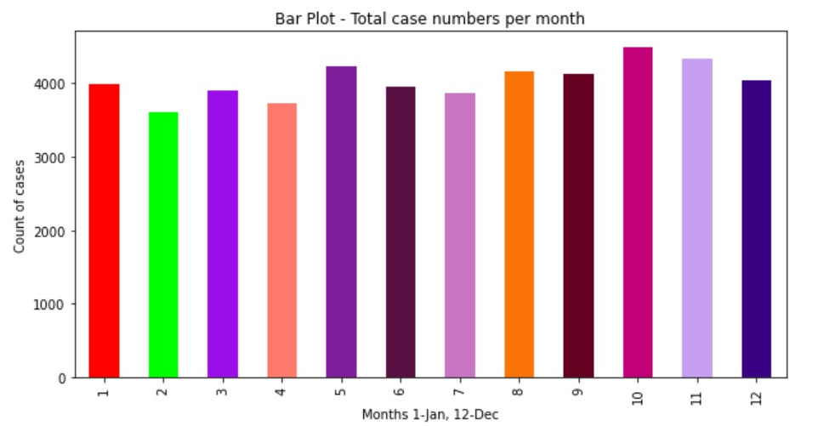
Visualization – Monthly accidents

Slide 21
Analysis
Why are most accidents taking place in the months of October, November, December?
The higher number of holiday accidents is due to a multitude of factors that occur throughout the holiday season.
Overall, there is more traffic on the roads. People are more distracted and are stress driving
Fatigued Driving, Drunk Driving
Unfamiliarity to the roads
Lastly, as it starts to get cooler it also starts to get darker sooner

Slide 22
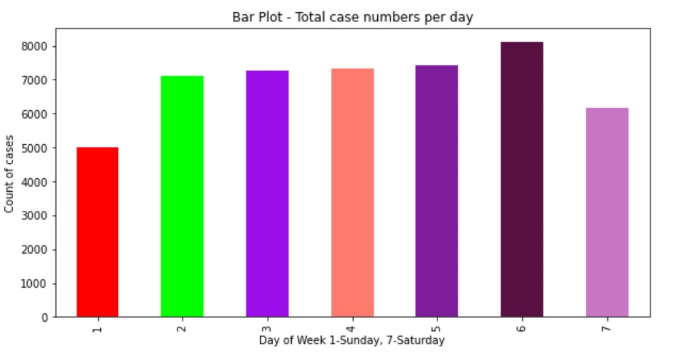
Visualization – Daily accidents

Slide 23
Analysis
Why are most accidents taking place on Friday?
As we can see from the bar graph, car crashes on weekdays are practically identical, however there are more car crashes on Friday and Saturday since people are all coming home for the weekend.
According to a study, more people are consuming alcohol on the weekends, and more people are also feeling relaxed after the work week. This leads to more drunk driving crashes, as well as auto accident injuries resulting from speeding and other forms of reckless driving.

Slide 24
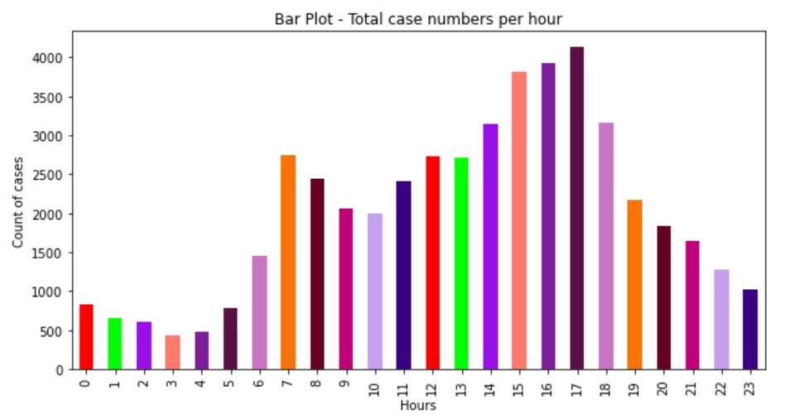
Visualization – HOURLY accidents

Slide 25
Analysis
Why are most accidents taking place in rush hours (3PM – 6PM)?
Believe it or not, most auto accident injuries and fatalities happen during rush hour on most days of the week
A number of these collisions result from people returning home after office hours, aggressive driving and tailgating

Slide 26
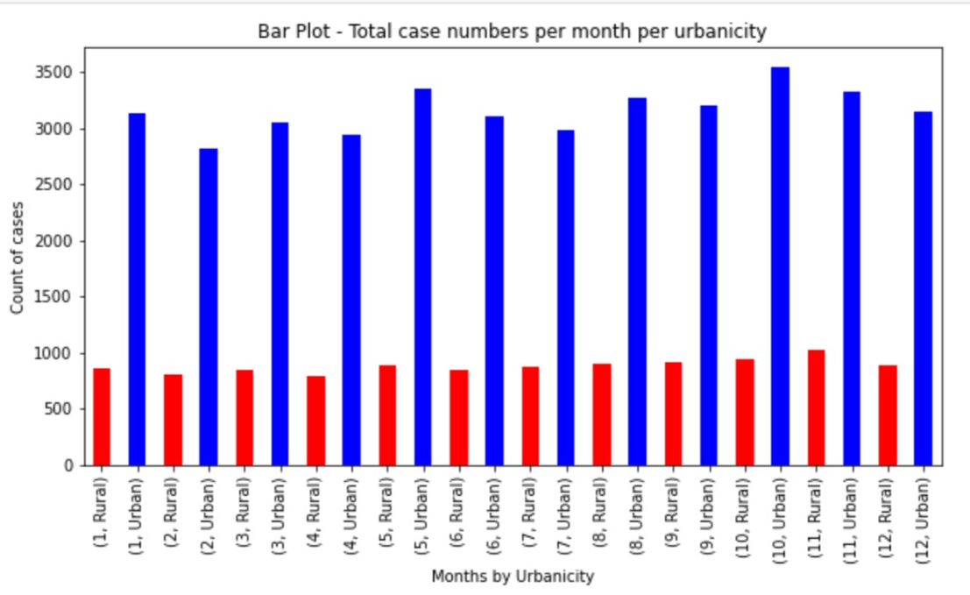
Visualization – HOURLY accidents by urbanicity

Slide 27
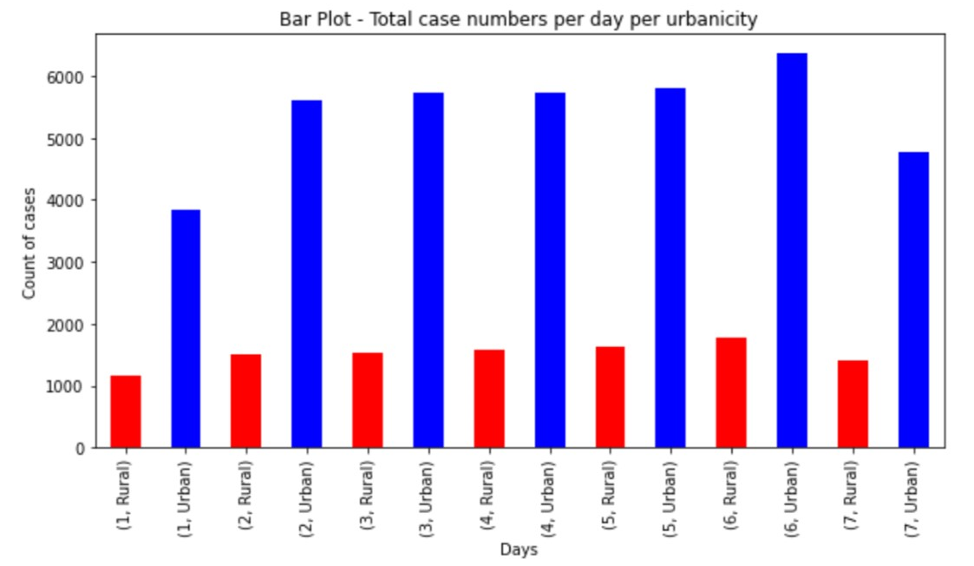
Visualization – DAILY accidents by urbanicity

Slide 28
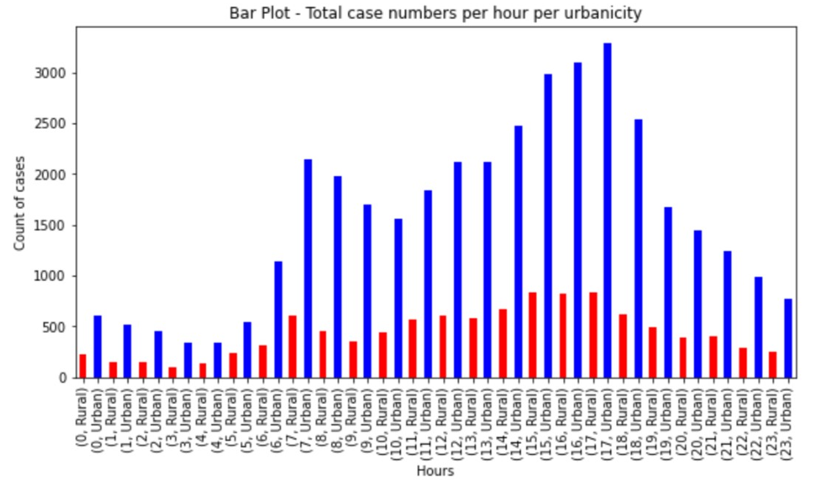
Visualization – HOURLY accidents by URBANICITY

Slide 29
Analysis
The accompanying figures clearly show that most car accidents occur in urban settings. In comparison to rural areas, urban areas have 30-40% more crashes.
Car accidents in cities are caused by several common factors:
Tailgating, dangerous driving (including speeding and incorrect lane changes), and road rage are all caused by large traffic volumes on multi-lane highways
One-way streets and a limited number of U-turns
Potholes can cause drivers to lose control of their vehicles or damage the tires on their automobiles.
It is exceedingly dangerous for drivers to run red lights.
Notes:
One observation for rural areas: the number of cases is identical monthly and daily.. While it differs slightly hourly

Slide 30
Thank you!

